Slide 1

Notes:
*Create new design for this (Graphics)

Slide 2
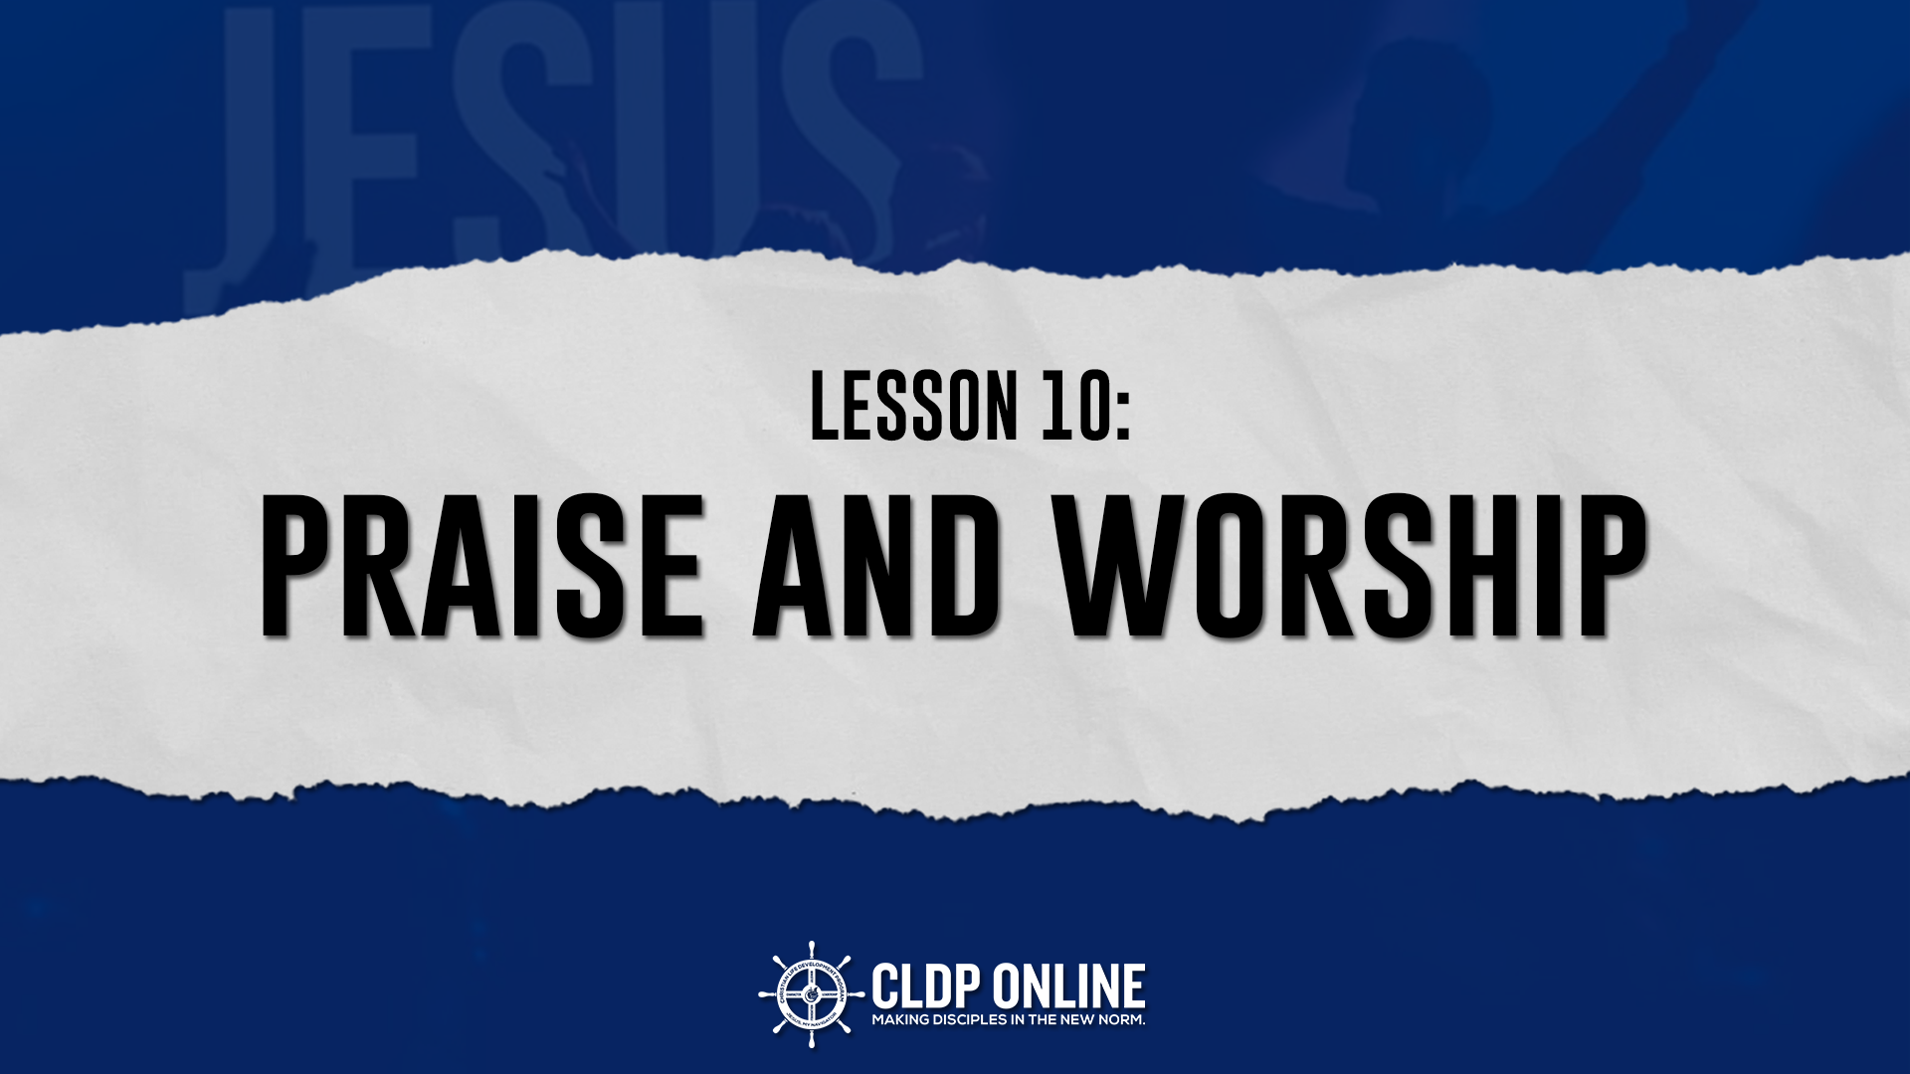

Slide 3
Notes:
Script: As one continues to grow in his Cristian life, he must learn to walk closer with the Lord Jesus Christ. Our intimacy with Christ increases as we dwell on His Word and as we meet Him in prayer . But there is one more way in which our mind and heart satys with God.
Walking with God through reading the word and prayer- graphics

Slide 4
Notes:
An that is through prayer and worship.
It is our supreme dury for all eternity to give reverence and adoration to our Lord, not only for what He has done (praise) but who God is (worship)

Slide 5
Notes:
Worship as a lifestyle- artistic graphics (it should be seen in every day life, words and thoughts.
Script: But praise and worship is not only found in the form of words of songs but it is seen in our life.
Praise and worship which is another ingredient of for a victorious Christian walk, is to become a lifestyle. It must assume our every thought, word and be the very atmosphere we breathe.
Right now you might be saying, “sure, I’d like to have a lifestyle of praise and worship but I don’t know how. I’m not even sure what is the proper way to praise God.”
Let us turn to Psalm 95, to learn how.

Slide 6

Psalm 95:1-2
¹ Come, let us sing for joy to the LORD; let us shout aloud to the Rock of our salvation.
² Let us come before him with thanksgiving and extol him with music and song.
Notes:
*People singing (Graphics)

Slide 7
WHAT IS PRAISE?
How is praise describe?
¹ Come, let us sing for joy to the LORD; let us shout aloud to the Rock of our salvation.
² Let us come before him with thanksgiving and extol him with music and song.
Psalm 95:1-2
Notes:
*Praise picture background (artistic)

Slide 8
WHAT IS PRAISE?
Praise is an expression of THANKSGIVING for what God has done in our lives, for SAVING us and giving CHRIST who is our REDEEMER.
Praise is a DECLARATION of God’s ATTRIBUTES and His great GLORY.
Notes:
*Make this a separate slide
2. Praise God verbally!
Never run out of reasons to praise God!
3. Thru the good times and bad!
*Same background of slide 3

Slide 9
WHY DO WE PRAISE?
The LORD is the GREAT GOD.
For the LORD is the great God, the great King above all gods.
Psalm 95:3
Notes:
Script - We praise God bec he is a perfect God! An all-knowing God! An all-powerful God! The God who heals, provides, makes miracles.
*Glory of the Lord (Graphics)

Slide 10
WHY DO WE PRAISE?
The LORD is the CREATOR of all things.
⁴ In his hand are the depths of the earth, and the mountain peaks belong to him.
⁵ The sea is his, for he made it, and His hands formed the dry lands.
Psalm 95:3
Notes:
*Creation of the world (Graphics)

Slide 11
HOW DO WE PRAISE?
TOWDAH – a sacrifice of thanksgiving or praise initiated in the believer’s will.
Enter his gates with thanksgiving and his courts with praise; give thanks to him and praise his name.
Psalm 100:4
Notes:
*Thanks Giving (Graphics)
Verse – another slide

Slide 12
HOW DO WE PRAISE?
YADAH – to raise one’s hand in praise to God; to thrust our praise to Him.
Lift up your hands in the sanctuary and praise the LORD.
Psalm 134:2
Notes:
*Raising once hand (Graphics)
Verse – People lifting their hands in sanctuary (Picture)
Verse - Separate Slide

Slide 13
HOW DO WE PRAISE?
BARAK – to quietly, reverently adore the LORD.
But I, by your great mercy, will come into your house; in reverence will I bow down toward your holy temple.
Psalm 5:7
Notes:
Bowing down worship (Graphics)
Verse – Separate slide

Slide 14
HOW DO WE PRAISE?
HALAL – to celebrate the LORD; to be clamorously foolish in praising him.
Notes:
*David foolishly praising God or a person who is not self conscious the point appearing foolish / lost self in praising God (Artistic Picture)

Slide 15
Psalm 150
¹ Praise the LORD. Praise God in his sanctuary; praise him in his mighty heavens. ² Praise him for his acts of power; praise him for his surpassing greatness. ³ Praise him with the sounding of the trumpet, praise him with the harp and lyre,
Notes:
*Make plain artistic background

Slide 16
Psalm 150
⁴ praise him with tambourine and dancing, praise him with the strings and flute, ⁵ praise him with the clash of cymbals, praise him with resounding cymbals. ⁶ Let everything that has breath praise the LORD. Praise the LORD.
Notes:
*Make plain artistic background

Slide 17
HOW DO WE PRAISE?
ZAMAR – to praise the LORD by playing a musical instrument.
Praise the LORD with the harp; make music to him on the ten-stringed lyre.
Psalm 33:2
Notes:
*Using modern instruments like guitar, drums or piano (Graphics)
Verse – Separate Slide

Slide 18
HOW DO WE PRAISE?
TEHILLAH – a song from the (human) spirit.
O my God, I cry out by day, but you do not answer, by night, and am not silent. Yet you are enthroned as the Holy One; you are the praise of Israel.
Psalm 22:3
Notes:
*Singing (Graphics)
Verse – Separate Slide

Slide 19
HOW DO WE PRAISE?
SHABACH – to shout; to address in a very loud tone.
Because your love is better than life, my lips will glorify you.
Psalm 22:3
Notes:
*Shouting (Graphics)
Verse – Separate Verse

Slide 20
WHAT IS WORSHIP?
Worship is an expression of ADORATION and LOVE for who God is.
Worship is a deep COMMUNION and FELLOWSHIP with the LORD.
Notes:
*Love for God (Graphics)
Make it Separate Slides
*Deep Communion with God (Graphics)

Slide 21
1 Chronicle 16:29
Give unto the Lord the glory due unto His name: bring an offering, and come before him: worship the Lord our maker.
Notes:
*Offering (Graphics)

Slide 22
Psalm 96:9
O worship the Lord in the beauty of Holiness: fear before Him , all the earth
Notes:
* Beauty of holiness (Graphics)

Slide 23
WHY DO WE WORSHIP?
God is our MAKER.
God is our SHEPHERD.
Come, let us bow down in worship, let us kneel before the LORD our Maker; ⁷ for he is our God and we are the people of his pasture, the flock under his care.
Psalm 95:6-7
Notes:
*God is our Maker (Graphics)
*Separate slide
*God is our Shepherd (Graphics)

Slide 24
HOW DO WE WORSHIP?
We worship by INVITATION.
¹ Come, let us sing for joy to the LORD; let us shout aloud to the Rock of our salvation. …
⁶ Come, let us bow down in worship, let us kneel before the LORD our Maker;
Psalm 95:1, 6
Notes:
Invitation of Worship Leader in Stage (Picture)
Verse – Separate Slid

Slide 25
HOW DO WE WORSHIP?
We worship TOGETHER.
¹ Come, let us sing for joy to the LORD; let us shout aloud to the Rock of our salvation. ² Let us come before him with thanksgiving and extol him with music and song…
Psalm 95:1-2
Notes:
*Worship Together (Artistic Pictures)

Slide 26
HOW DO WE WORSHIP?
We worship TOGETHER.
⁶ Come, let us bow down in worship, let us kneel before the LORD our Maker;
Psalm 95:6
Notes:
*Worship Together (Artistic Picture)

Slide 27
HOW DO WE WORSHIP?
We worship GOD ALONE.
¹ Come, let us sing for joy to the LORD; let us shout aloud to the Rock of our salvation…
Psalm 95:1
Notes:
* Person who are crying while worshipping (Artistic Picture)

Slide 28
HOW DO WE WORSHIP?
We worship GOD ALONE.
⁶ Come, let us bow down in worship, let us kneel before the LORD our Maker;
Psalm 95:6

Slide 29
HOW DO WE WORSHIP?
We worship HUMBLY.
⁶ Come, let us bow down in worship, let us kneel before the LORD our Maker;
Psalm 95:6
Notes:
*person who are kneeling down in altar (Artistic Picture)

Slide 30
HOW DO WE WORSHIP?
We worship IN OBEDIENCE.
⁷ For he is our God and we are the people of his pasture, the flock under his care. Today, if you hear his voice, ⁸ do not harden your hearts as you did at Meribah, as you did that day at Massah in the desert,
Psalm 95:7-8
Notes:
*Worship in Obedience (Graphics)
Assignment:
1. With your full name, write down God’s blessings in your life. Example: JOANAVIEVE DINO

