Slide 3
THE LAW OF REPRODUCTION IN MAN
EVERY LEADER MUST REALIZE THAT HE IS GOING TO REPRODUCE HIMSELF IN THOSE UNDER HIM.

Slide 4
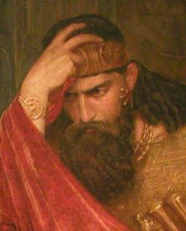
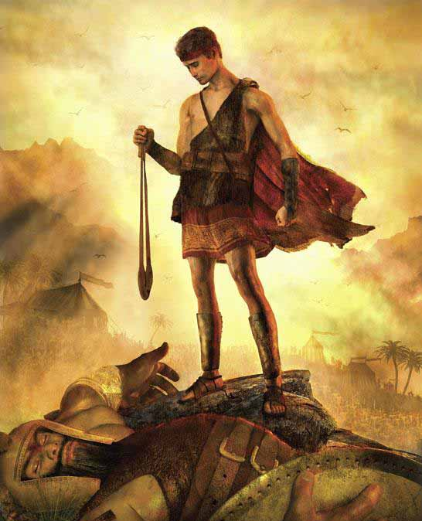
THE LAW OF REPRODUCTION IN MAN
DAVID: The Warrior Who
Reproduced Other Warriors.
Saul – COWARD, average.
(1 Samuel 17:23-25)
David – COURAGEOUS and brave.
(1 Samuel 22:1-2; 2 Samuel 23:8-23)
Notes:
Add pictures of the bible character. One bible character per slide lang.

Slide 5
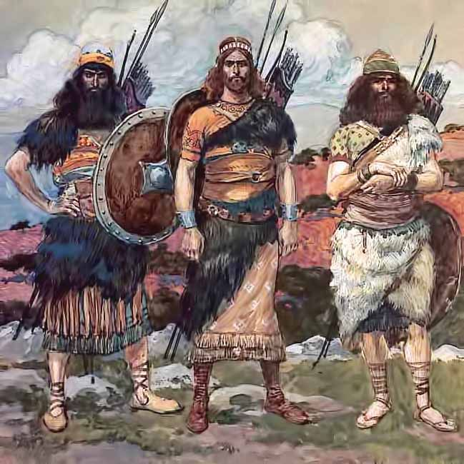
THE LAW OF REPRODUCTION IN MAN
JOSHEB – slew 800 men with a spear in one battle, v. 8
ELEAZAR – struck down Philistines until his hands clung to sword, vs. 9,10
SHAMMAH – defended a plot of grounds, vs. 11-12
Notes:
Add pictures of the bible character. One bible character per slide lang.

Slide 6
What we see, hear from our LEADER is what we will BECOME.

Slide 7
Paul: REPRODUCTION in Timothy and Titus.
“And the things you have heard me say in the presence of many witnesses entrust to reliable men who will also be qualified to teach others.”
2 Timothy 2:2

Slide 8
Timothy
Other
Paul
Titus
Faithful
Another
Men
Notes:
Improve natin ito. Ang gloomy HAHA.

Slide 9
THE PROCESS OF TRAINING LEADERS
1. MODEL (THE PRINCIPLE OF INCARNATION)
The leader serves as a real-life, tangible, observable example for others to follow. Leader do, followers watch. Performed correctly and completely.
Notes:
Lez improve this lang.

Slide 10
THE PROCESS OF TRAINING LEADERS
2. MENTOR (THE PRINCIPLE OF ASSOCIATION)
The leader helps followers gain experience and insight by investing time with them. The follower comes alongside and assists in the process.
Notes:
Lez improve this lang.

Slide 11
THE PROCESS OF TRAINING LEADERS
3. MONITOR (THE PRINCIPLE OF TRAINING)
The leader freely shares wisdom with the followers and equips them to perform the work properly and effectively. The follower performs the tasks and the leader will assist and correct.
Notes:
Lez improve this lang.

Slide 12
THE PROCESS OF TRAINING LEADERS
4. MOTIVATE (THE PRINCIPLE OF EXPECTATION)
The leader casts a vision for followers, letting them know they are expected to carry on the mission and building upon what has already been achieved. At this point the leader will step out of the task and allow the new leader to go.
Notes:
Lez improve this lang.

Slide 13
THE PROCESS OF TRAINING LEADERS
5. MULTIPLY (THE PRINCIPLE OF REPRODUCTION)
The new leader takes turn to teach other also.
Notes:
Lez improve this lang.

Slide 14
“Leaders don’t flock, you have to find them one at a time.”
- Ross Perot, Industrial Magnate

