Slide 1


Slide 2
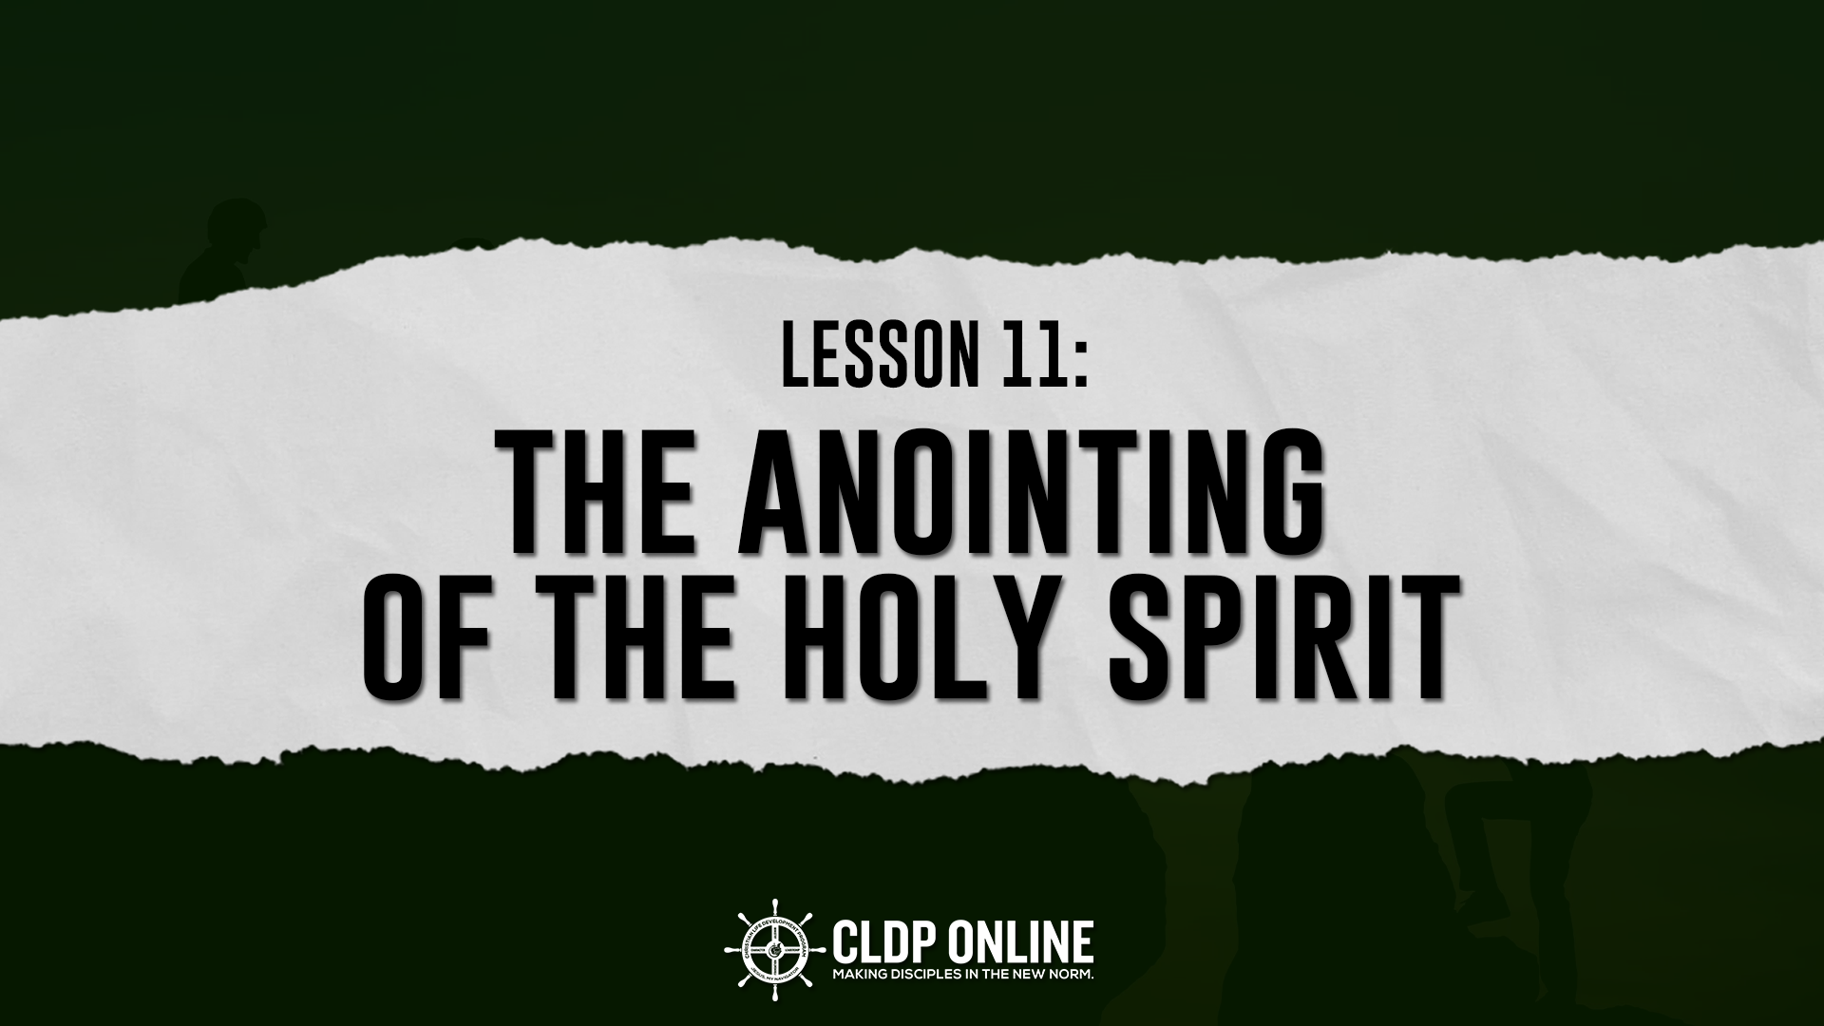

Slide 3
Do you want to be SUCCESSFUL in life?
Do you want to be SUCCESSFUL in life?
SECULAR:
study; improve our skills;
extra curricular activities
SPIRITUAL:
ANOINTING of the Holy Spirit

Slide 4
Do you want to be SUCCESSFUL in life?
Schools, seminaries will teach us the “HOW TO DO IT” principles: how to baptize, conduct child dedication and funeral service; and church growth.
What if the “how to” does not WORK?

Slide 5
WHAT IS ANOINTING?
IT IS NOT:
1. Mere ABILITY or talent.
2. PROFESSIONALISM or a good voice/music.
3. Good SPEAKING technique.
4. Direct result of good EDUCATION.
5. Mere EMOTIONALISM.
6. Quiet RELIGIOUS meeting; or pa-spiritual effect.

Slide 6
WHAT IS ANOINTING?
ANOINTING = HUMBLE + BROKEN Heart (born-out of)
It is: Hebrew
BALAL - to overflow.
DASHEN - to be fat; satisfied.
YITSHAR - oil to produce light.
MASHACH - to rub with oil thus, to consecrate.

Slide 7
WHAT IS ANOINTING?
It is: Greek
CHRIO - to smear or rub upon by using oil.
CONSECRATED - dedicated to God for His divine purpose.
Holy in character thus, set apart for divine use

Slide 8
WHAT IS ANOINTING?
It is: English
QUICKENING
to make alive;
to revive;
to burn more intensely
to accelerate
to shine more brightly

Slide 9
ANOTHER WAY OF DEFINING ANOINTING:
When God uses the VESSEL to heal the sick, deliver sinners, and vessel of POWER of God.

Slide 10
²¹ Therefore if anyone cleanses himself from the latter, he will be a vessel for honor, sanctified and useful for the Master, prepared for every good work.
2 Timothy 2:21

Slide 11
ANOTHER WAY OF DEFINING ANOINTING:
When God uses the VESSEL to heal the sick, deliver sinners, and vessel of POWER of God.
When God goes BEYOND the NATURAL ability of the man and gives him SUPERNATURAL ability.
Notes:
Limit of one bullet/item per slide.

Slide 12
⁴ And my speech and my preaching were not with persuasive words of human wisdom, but in demonstration of the Spirit and of power, ⁵ that your faith should not be in the wisdom of men but in the power of God.
1 Corinthians 2:4-5

Slide 13
ANOTHER WAY OF DEFINING ANOINTING:
When the leader SENSES that God is very near Him and after that he REPENTS for his sins and MINISTER to his congregation in the same spirit.
Notes:
Limit of one bullet/item per slide.

Slide 14
But the anointing which you have received from Him abides in you, and you do not need that anyone teach you; but as the same anointing teaches you concerning all things, and is true, and is not a lie,
and just as it has taught you, you will abide in Him.
1 John 2:27

Slide 15
However, when He, the Spirit of truth, has come, He will guide you into all truth; for He will not speak on His own authority, but whatever He hears He will speak; and He will tell you things to come.
John 16:13

Slide 16
DEFINITION
The anointing of GOD’S SPIRIT is the OVERFLOWING of the MESSIAH’S DIVINE life of HOLINESS into a HUMAN LIFE.

Slide 17
“The Spirit of the Lord is upon Me, Because He has anointed Me To preach the gospel to the poor;
Luke 4:18a

Slide 18
So he said to me, “This is the word of the Lord to Zerubbabel: ‘Not by might nor by power, but by my Spirit,’ says the Lord Almighty.
Zechariah 4:6 NIV

Slide 19
WHAT ARE THE REQUIREMENTS TO ATTAIN THE ANOINTING?
1. DISCIPLINE in pursuing a deep prayer life.

Slide 20
⁹ For this reason, since the day we heard about you, we have not stopped praying for you and asking God to fill you with the knowledge of his will through all spiritual wisdom and understanding.
Colossians 9:9-10

Slide 21
¹⁰ And we pray this in order that you may live a life worthy of the Lord and may please him in every way: bearing fruit in every good work, growing in the knowledge of God.
Colossians 9:9-10

Slide 22
WHAT ARE THE REQUIREMENTS TO ATTAIN THE ANOINTING?
DISCIPLINE in pursuing a deep prayer life.
TRUE Spiritual meditation on the Word of God.

Slide 23
Do not let this Book of the Law depart from your mouth; meditate on it day and night,
so that you may be careful to do
everything written in it. Then you will be prosperous and successful.
Joshua 1:8

Slide 24
WHAT ARE THE REQUIREMENTS TO ATTAIN THE ANOINTING?
DISCIPLINE in pursuing a deep prayer life.
TRUE Spiritual meditation on the Word of God.
RIGHTEOUSNESS.

Slide 25
The Lord delight in a way man whose steps made firm, though he stumble he will not fall, for the hand of the Lord will uphold Him.
Psalm 37:23

Slide 26
HOW TO MAINTAIN THE ANOINTING?
1. Keep a HUMBLE heart at all times. (e.g. Satan in Ezekiel 28:14)
2. Remain OPEN to the specific and different ways the Spirit may lead us to SAVE souls.

Slide 27
WHAT ARE THE PURPOSES OF ANOINTING?
To enable people PERFORM their MINISTRIES unto the Lord.
To GLORIFY the Lord and not man.
(Isaiah 61: 1-3)

Slide 28
WHAT ARE THE PURPOSES OF ANOINTING?
To QUALIFY people for the ministries.
(Exodus 40: 15)
To EMPOWER the Christians with the GIFTS and MINISTRIES of the Lord. (1 Corinthians 12; Ephesians 4: 11-12)

