Slide 3
“Blessed are the pure in heart, for
they will see God.”
Matthew 6:8
New International Version
Pure - “Katharos” (Greek)
pure, unpolluted, complete desire
Notes:
pure and unpolluted - walang bahid ng karumihan

Slide 4
Heart - “Kardia” (Greek)
refers to the CHIEF ORGAN of physical life
(Leviticus 17:11)
stands for man’s entire MENTAL and MORAL activity, both the RATIONAL and the EMOTIONAL elements.
Notes:
Heart (as chief organ) - the heart is the organ that pumps blood throughout the body, supplies oxygen and nutrients to the tissues’ and ‘removes wastes and other wastes’. I will try to go into details about this later on...
Let me share to you some interesting facts about the heart:
It weighs about 200 to 450 grams (or roughly about ¼ to ½ kilo) and is just a little bigger than your “fist”.
It beats around 100,000 times a day; and pumps 2,000 gallons of blood a day!
By the end of a long life, a person’s heart may have beat =en (expanded and contracte) more than 3.5 billion times!

Slide 5
Heart - “Kardia” (Greek)
stands for man’s entire MENTAL and MORAL activity, both the RATIONAL and the EMOTIONAL elements.
Notes:
Heart (as chief organ) - the heart is the organ that pumps blood throughout the body, supplies oxygen and nutrients to the tissues’ and ‘removes wastes and other wastes’. I will try to go into details about this later on...
Let me share to you some interesting facts about the heart:
It weighs about 200 to 450 grams (or roughly about ¼ to ½ kilo) and is just a little bigger than your “fist”.
It beats around 100,000 times a day; and pumps 2,000 gallons of blood a day!
By the end of a long life, a person’s heart may have beat =en (expanded and contracte) more than 3.5 billion times!

Slide 6
THE HIDDEN SPRINGS OF THE PERSONAL LIFE
The hidden springs of the personal life.
“Above all else, guard your heart, for it is the wellspring of life.”
Proverbs 4:23
New International Version
Notes:
Walang bahid ng karumihan

Slide 7
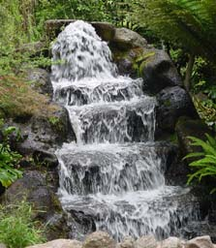
The wellspring of life

Slide 9
COMPARISON BETWEEN
PHYSICAL HEART
SPIRITUAL HEART
Location:
CENTER of
man’s breast
Very CENTER of a leader’s THOUGHTS, WORDS, ACTIONS and MIND

Slide 10
COMPARISON BETWEEN
PHYSICAL HEART
SPIRITUAL HEART
Contents:
Blood contains NUTRIENTS that comes from the food we eat
Obtained by eating (reading) the WORD of God and from what he consumes through his MIND and EXPERIENCE.

Slide 11
COMPARISON BETWEEN
PHYSICAL HEART
SPIRITUAL HEART
Beating:
AUTOMATIC without
the conscious effort of the owner.
Shows God’s love, joy and peace NATURALLY, SPONTANEOUSLY without any insincere
put-on.

Slide 12
COMPARISON BETWEEN
PHYSICAL HEART
SPIRITUAL HEART
If functioning properly:
Blood is PUMPED from one end of the body to the other.
CIRCULATES the life of the Holy Spirit throughout the Body of Christ.

Slide 13
COMPARISON BETWEEN
PHYSICAL HEART
SPIRITUAL HEART
On Caring:
HIGH-Fat diet
Taking in RICH truths without practicing them

Slide 14
THE PHYSICAL HEART

Slide 15
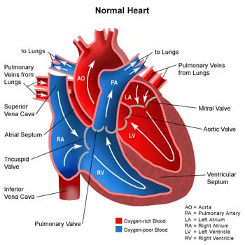
THE PHYSICAL HEART

Slide 16
COMPARISON BETWEEN
PHYSICAL HEART
SPIRITUAL HEART
On Caring:
ALCOHOLIC beverages
Dabbling with the wine of PLEASURES and CARES of the word

Slide 17
COMPARISON BETWEEN
PHYSICAL HEART
SPIRITUAL HEART
On Caring:
LESS exercise
Does not COMPLETELY perform the will of God

Slide 18
COMPARISON BETWEEN
PHYSICAL HEART
SPIRITUAL HEART
On Caring:
More TENSION and STRESS
High-adrenalin
lifestyle but NOT ENTRUSTING all cares to the Lord

Slide 19
COMPARISON BETWEEN
PHYSICAL HEART
SPIRITUAL HEART
On Caring:
INHERITED heart defects
Have not fully REPENTED at the time of spiritual rebirt

Slide 20
HOW TO CONQUER IMPURITY?
S – SHIELD yourself from the external influences of the world (Hebrew 11:25)
T – TREAT sin as your enemy (Rom. 12:9)
R – RUN from the lust of the flesh (2 Tim. 2:22a)
I – IMAGINE the consequences of your sin from those you love (Ex. 34:7b)
P – PURSUE righteousness, faith, love and peace (2 Tim. 2:22b)
Notes:
Free from the influences of sin

Slide 21
HOW TO HAVE A NEW START?
A – ASK for forgiveness (1 John 1:9)
1 – 180° Turn (2 Tim. 2:19)
D – DECIDE to let the Holy Spirit control you (Gal. 5:16)

Slide 22
CONCLUSION:
Create in me a pure heart, O God, and renew
a steadfast spirit within me. Do not cast me from
your presence or take your Holy Spirit from me. Restore to me the joy of your salvation
and grant me a willing spirit, to sustain me.
Psalm 51:10-12
New International Version

Slide 23
Assignment:
Bring a White Business Envelope
Enclose about 40 pcs. of paper cut from a short bond paper

