Slide 1
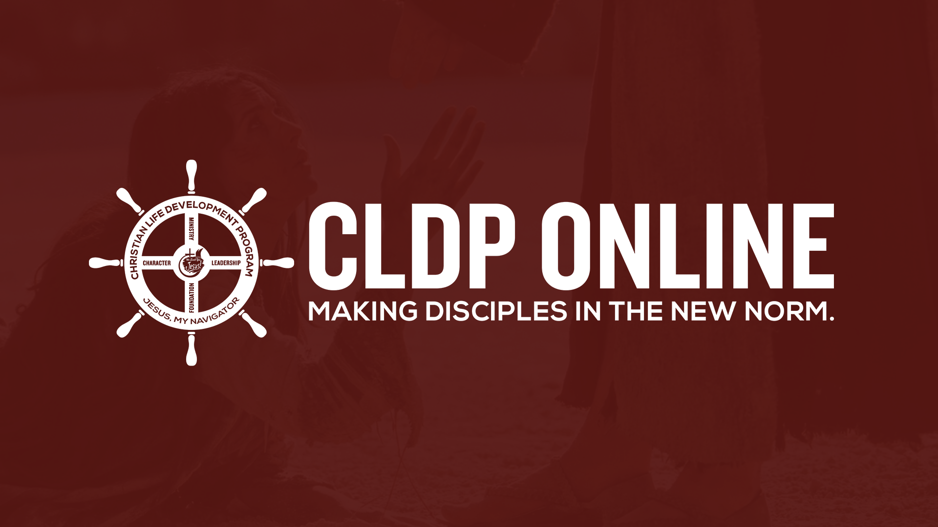

Slide 2
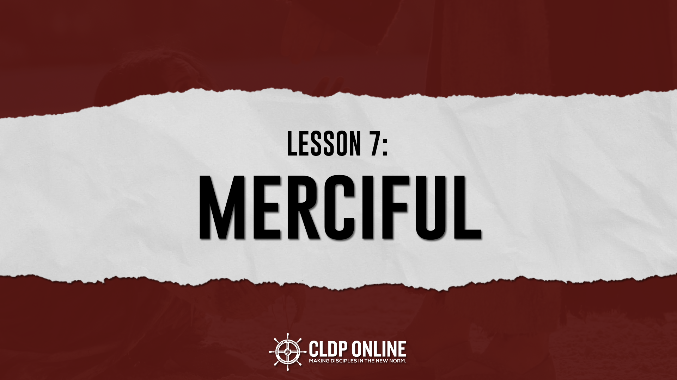
Notes:
The picture in slide 2 (title slide) can still be improved. We think that people element may be a good idea
slide 9: If it's okay, we can make the sentences parallel. For example: kindness to the poor and the needy, comfort for the spiritually down, unconditional forgiveness for all, care for the unbelievers, commitment to never to slander nor find fault.
Indicate relevant verses in slide 10

Slide 3
MERCIFUL
Blessed are the merciful, for they will receive mercy.
Matthew 5:6
New International Version

Slide 4
MERCIFUL
M E R C Y
Greek: Eleemon/Eleos
an OUTWARD MANIFESTATION of PITY
G R A C E
an UNDESERVED FAVOR
or GIFT

Slide 5
“... and are justified freely by his grace through the redemption that came by Christ Jesus.”
Romans 3:24
New International Version

Slide 6
God created man totally PERFECT and WHOLE .
BEFORE THE FALL
He placed him in a PERFECT environment that was in absolute harmony with man’s being.

Slide 7
Sin brought total DISHARMONY to man’s world.
AFTER THE FALL
Despite the devastation and disharmony that resulted from the fall, God’s basic attitude towards his creation still REMAINED MERCIFUL.

Slide 8
LET’S STUDY THE FOLLOWING:
Genesis 3:21
God provided a covering for Adam and Eve.
Genesis 4:14-15
God showed mercy to Cain, the First murderer.

Slide 9
LET’S STUDY THE FOLLOWING:
3. Genesis 8:22
God sustained the earth physically.
4. Genesis 12:1-3
God took a step to redeem man from his
fallen state by calling Abraham.

Slide 10
WHAT DOES TO BE MERCIFUL INCLUDE?
1. KINDNESS to the poor and the needy.
2. COMFORT the spiritually down.
3. Willingness to FORGIVE unconditionally.

Slide 11
WHAT DOES TO BE MERCIFUL INCLUDE?
4. CARE for the unbelievers.
5. NEVER to slander nor find fault.

Slide 12
WHO ARE THE MERCIFUL?
Those who view the world as God DOES.
(Romans 8:22-23)
Those who feel the world as God FEELS. (Nehemiah 1:4-7)
Those who are MOTIVATED to be merciful through the RENEWING work of the Holy Spirit.

Slide 13
THE PRACTICAL ILLUSTRATION OF MERCY
(LUKE 10:25-37)
Distressed Traveller
Mischief
Priest/Levite
Passes by the other side
The Good Samaritan
Poured Oil/Wine
SATAN
LAW OF MOSES
OWES US
NO RELIEF
JESUS
TOOK CARE OF US

Slide 14
SUMMARY
  The merciful are those who act to heal the whole man (body, soul, spirit) following the good example of the Good Samaritan.

