Slide 2
Notes:
We can use a more related picture (to character) here.

Slide 3
CHARACTER
(Greek) “Charasso” – means a MARK, an EMBOSSER or a SCRATCH.
also translated as a MARK or a quality that DISTINGUISHES one from the rest.

Slide 4
CHARACTER
the COMBINATION of qualities or features that DISTINGUISHES one person, group, or thing from another.

Slide 5
FACTORS THAT INFLUENCE OUR CHARACTER
NATURAL FACTORS
Heredity
Notes:
Heredity - the passing on of physical or mental characteristics genetically from one generation to another

Slide 6
FACTORS THAT INFLUENCE OUR CHARACTER
NATURAL FACTORS
Heredity
Upbringing
Notes:
Upbringing - the treatment and instruction received by a child from its parents throughout its childhood. “Paano tayo pinalaki?”

Slide 7
FACTORS THAT INFLUENCE OUR CHARACTER
NATURAL FACTORS
Heredity
Upbringing
Education
Notes:
Education - a body of knowledge acquired while being educated

Slide 8
FACTORS THAT INFLUENCE OUR CHARACTER
NATURAL FACTORS
Heredity
Upbringing
Education
Experience

Slide 9
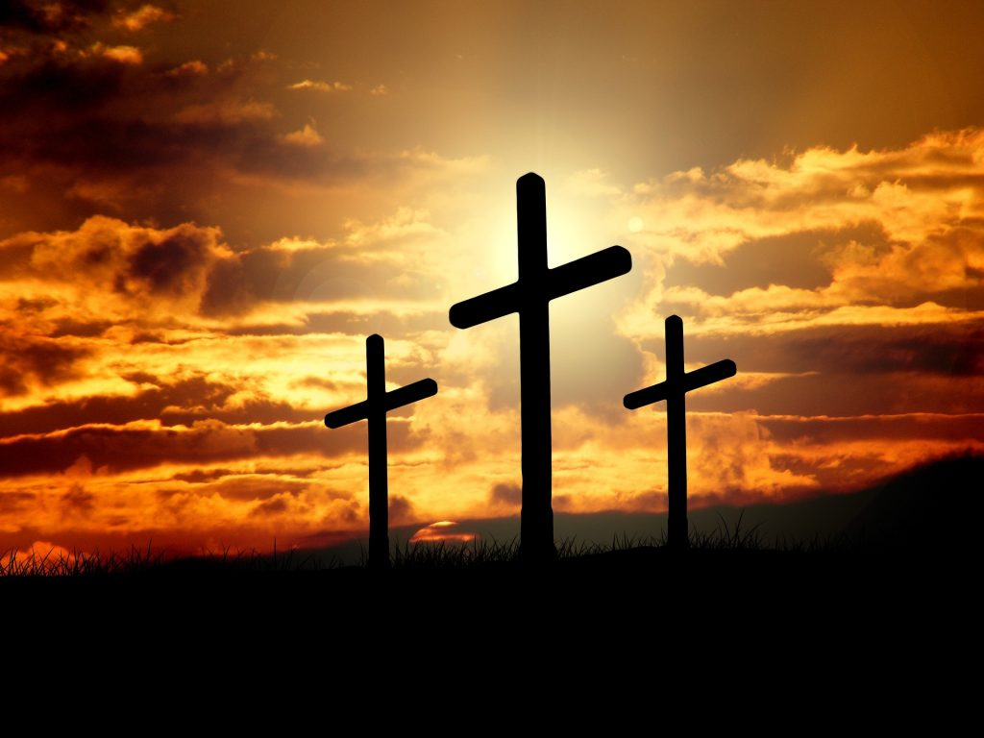
FACTORS THAT INFLUENCE OUR CHARACTER
SPIRITUAL FACTORS
Christ

Slide 10
“To them God has chosen to make known among the Gentiles the glorious riches of this mystery, which is Christ in you, the hope of glory.”
Colossians 1:27
New International Version

Slide 11
FACTORS THAT INFLUENCE OUR CHARACTER
SPIRITUAL FACTORS
Christ
Fruit of the Spirit

Slide 12
“ ²² But the fruit of the Spirit is love, joy, peace, patience, kindness, goodness, faithfulness, ²³ gentleness and self-control.”
Galatians 5:22-23
New International Version

Slide 13
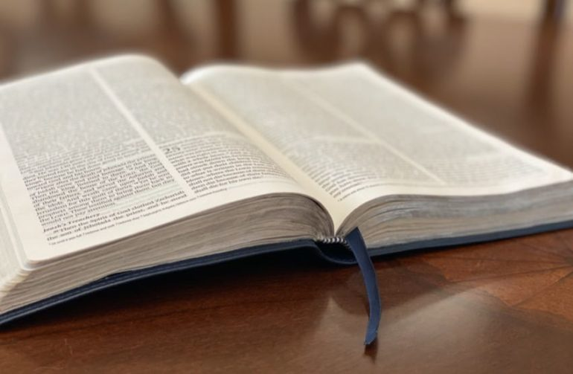
FACTORS THAT INFLUENCE OUR CHARACTER
SPIRITUAL FACTORS
Christ
Fruit of the Spirit
Word of God

Slide 14
“Your word is a lamp to my feet and a light for my path.”
Psalm 119:105
New International Version

Slide 15
FACTORS THAT INFLUENCE OUR CHARACTER
SPIRITUAL FACTORS
Christ
Fruit of the Spirit
Word of God
Holy Spirit

Slide 16
“But when he, the Spirit of truth, comes, he will guide you into all truth.”
John 16:13a
New International Version

Slide 17
FACTORS THAT INFLUENCE OUR CHARACTER
SPIRITUAL FACTORS
Christ
Fruit of the Spirit
Word of God
Holy Spirit
Dealings of God

Slide 18
⁵ And you have forgotten that word of encouragement that addresses you as sons: “My son, do not make light of the Lord‘s discipline, and do not lose heart when he rebukes you,
Hebrews 12:5-6
New International Version

Slide 19
⁶ because the Lord disciplines those he loves, and he punishes everyone he accepts as a son.”
Hebrews 12:5-6
New International Version

Slide 20
NATURAL FACTORS
+
EQUALS
SPIRITUAL FACTORS
YOU

Slide 21
WHAT CHARACTER “IS” AND “IS NOT”?
It is NOT ...
what/who a person will ideally be in the future.
It is ...
1. what/who a person is at present.

Slide 22
WHAT CHARACTER “IS” AND “IS NOT”?
It is NOT ...
2. what one shows externally.
It is ...
2. who one is internally.

Slide 23
WHAT CHARACTER “IS” AND “IS NOT”?
It is NOT ...
3. what appears when one has no pressure.
It is ...
3. one’s reaction in times of pressure.

Slide 24
WHAT CHARACTER “IS” AND “IS NOT”?
It is NOT ...
4. commenting on the behavior of others.
It is ...
4. living by example.

Slide 25
WHAT CHARACTER “IS” AND “IS NOT”?
It is NOT ...
5. limited to one’s relationship with his spiritual family.
It is ...
5. which shows forth godly principles in every situation and toward every person.

Slide 26
THUS, CHARACTER IS
THE COMBINATION OF STRONG INNER SOURCES WHICH COMPRISE THE TRUE PERSON.

Slide 27
The Son is the radiance of God’s glory and the exact representation of His being, sustaining all things by His powerful word.
Hebrews 1:3
New International Version

Slide 28
Man’s quest for character must begin with GOD!
CHRIST is the very
CHARACTER of GOD!

Slide 29
For those God foreknew, he also predestined to be conformed to the likeness of His Son ...
Romans 8:29a
New International Version

Slide 30
CONCLUSION:
All the spiritual influences which God has brought into our lives combine to produce in us a Godly character, TRANSFORMING us into the image and likeness of Christ, who is the expressed image of the Father.

Slide 31
MEMORY VERSE #2
Your attitude should be the same as that of Christ Jesus...
Philippians 2:5
New International Version

Slide 32
Assignment #2: List down your strengths and weaknesses.
Strengths Weaknesses
Mapagpasensya Matatakutin
Maunawa Matampuhin
Masinop Tamad

