Slide 3
¹³ You are the salt of the earth. But if the salt loses its saltiness, how can it be made salty again? It is no longer good for anything, except to be thrown out and trampled by men.
Matthew 5:13-16
New International Version

Slide 4
¹⁴ You are the light of the world. A city on a hill cannot be hidden.
Matthew 5:13-16
New International Version

Slide 5
¹⁵ Neither do people light a lamp and put it under a bowl. Instead they put it on its stand, and it gives light to everyone in the house.
Matthew 5:13-16
New International Version

Slide 6
¹⁶ In the same way, let your light shine before men, that they may see your good deeds and praise your father in heaven.”
Matthew 5:13-16
New International Version

Slide 7
PROPERTIES OF SALT
PRESERVATIVE
to prevent decay
A disciple can retard the corruption of this world.

Slide 8
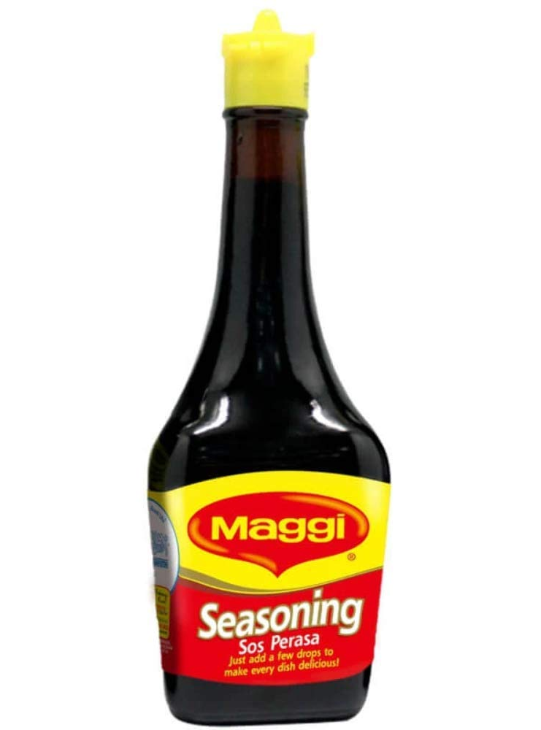
PROPERTIES OF SALT
SEASONING
to give flavor
A disciple has a powerful effect in this world.

Slide 9
PROPERTIES OF SALT
ANTISEPTIC
to help purify
to intercede on behalf of other people

Slide 10
PROPERTIES OF SALT
TRANSPARENT
see–through
A disciple cannot hide himself from this world.

Slide 11
PROPERTIES OF SALT
LOW FREEZING (-21°C) AND HIGH BOILING (1,465°C) POINT
A disciple must lead a disciplined life.

Slide 12
On the other hand…
Polluted salt is USELESS and HARMFUL.

Slide 13
YOU ARE THE LIGHT OF THE WORLD
L - Lamp
I - Illumination
G - God has put you on display
H - Have a heart to share
T - Trust in the Lord

Slide 14
CONCLUSION:
CHRIST is the ORIGINAL SALT and LIGHT.

