Slide 1
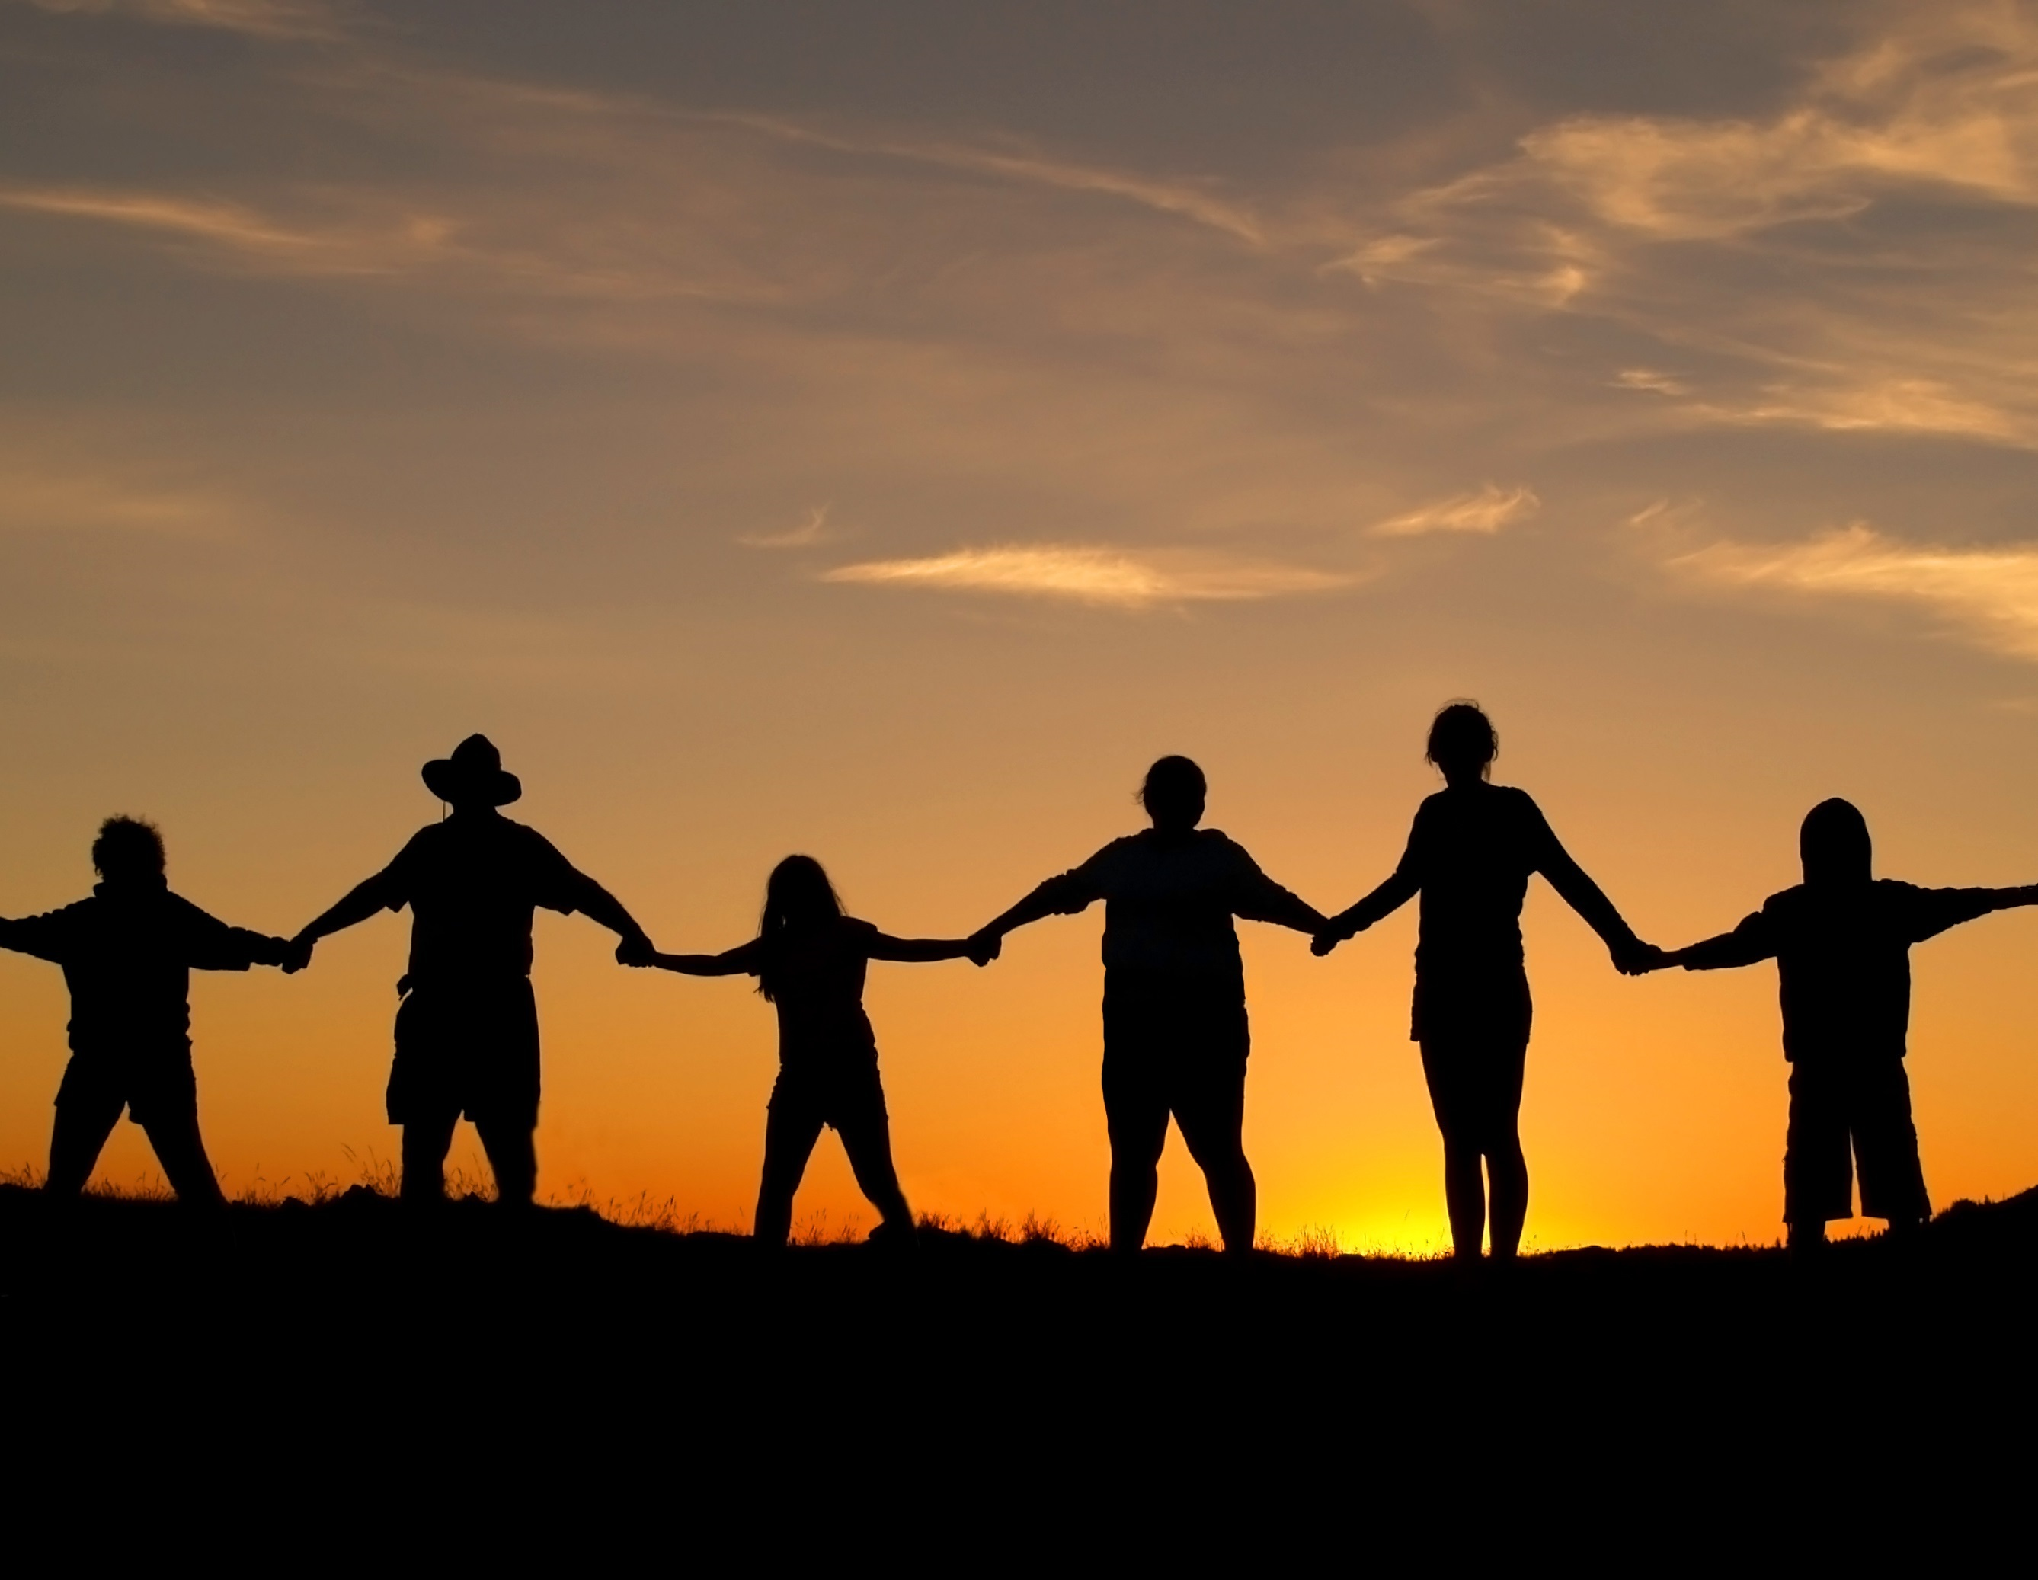
LESSON 9:
PEACEMAKER

Slide 2
“Blessed are the peacemakers , for they will be called the sons of God.”
Matthew 5:9

Slide 3
PEACE – (Gr.) “Eirene ”
the state of quietness
an ending or absence of hostility
a state of security and orderliness in a community

Slide 4
PEACE – (Gr.) “Eirenopois ”
Means a “pacifier”

Slide 5
SOURCE OF ALL CHAOS
SIN
NOTHING BUT
A NEW HEART
PEACE 
WILL BRING

Slide 6
WHO IS A PEACEMAKER?
one who promotes and encourages all that makes for God’s glory and harmony between men

Slide 7
WHO IS NOT?
troublemaker; agitator; spark plugs; instigators; insurgents; etc.
hostile; indifferent; angry; bitter; obsessively critical; judgmental; nit-picking

Slide 8
WHO IS DIOTREPHES?
Read 3 John 9-11
What had he done?
gossiping maliciously
refuses to welcome the brothers
also stops those who want to so (BI)
puts them (others) out of the church

Slide 9
ATTRIBUTES OF A PEACEMAKER
P – at peace with God

Slide 10
ATTRIBUTES OF A PEACEMAKER
P – at peace with God
at peace with his own heart
must have no hidden agenda; no selfish ambition
the perfect peacemaker: JESUS

Slide 11
ATTRIBUTES OF A PEACEMAKER
P – at peace with other people

Slide 12
ATTRIBUTES OF A PEACEMAKER
P – spiritually prosperous

Slide 13
ATTRIBUTES OF A PEACEMAKER
P – spiritually prosperous
has a right relationship with God
must live above chances; changes, circumstances in life
“Peace” is God’s highest good for man YAHWEH–SHALOM means “The Lord of Our Peace"

Slide 14
HOW CAN WE BECOME A PEACEMAKER?
“The Art of Making Peace” (Phil. 4:1-9)
lessons from Euodia and Syntyche

Slide 15
HOW CAN WE BECOME A PEACEMAKER?
Lesson 1: The peacemaker must love both sides.
(‘my brother, you whom I love and long for’; ‘my joy and crown’)

Slide 16
HOW CAN WE BECOME A PEACEMAKER?
Lesson 2: The peacemaker should treat both sides tenderly and equally.
(‘implore you’; ‘I beseech you’;
‘I plead with you’)

Slide 17
HOW CAN WE BECOME A PEACEMAKER?
Lesson 3: The peacemaker must seek oneness of mind; must reach a compromise.
(‘be of the same mind’;
‘agree with one another’)

Slide 18
HOW CAN WE BECOME A PEACEMAKER?
Lesson 4: The peacemaker must use assistance when available; the goal is to make peace not a reputation.

Slide 19
HOW CAN WE BECOME A PEACEMAKER?
Lesson 5: The peacemaker must see the good and give credit when due.
(‘… these women who have contended at my side in the cause of the gospel’)

Slide 20
CONCLUSION
²³ Don't have anything to do with foolish and stupid arguments, because you know they produce quarrels.
2 Timothy 2:23-26

Slide 21
CONCLUSION
²⁴ And the Lord's servant must not quarrel; instead, he must be kind to everyone, able to teach, not resentful.
2 Timothy 2:23-26

Slide 22
CONCLUSION
²⁵ Those who oppose him he must gently instruct, in the hope that God will grant them repentance leading them to a knowledge of the truth,
2 Timothy 2:23-26

Slide 23
CONCLUSION
²⁶ and that they will come to their senses and escape from the trap of the devil, who has taken them captive to do his will.
2 Timothy 2:23-26

