Slide 1
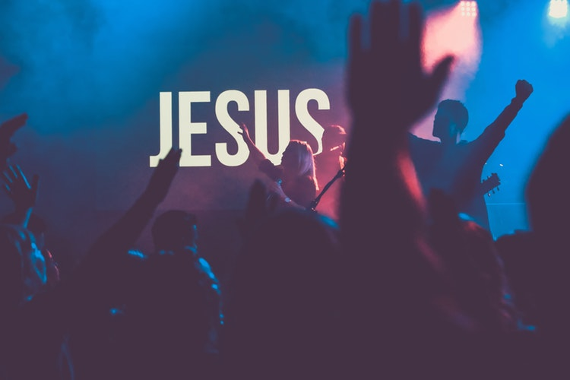
LESSON 10:
PRAISE AND
WORSHIP

Slide 2
Psalm 95:1-2
¹ Come, let us sing for joy to the LORD; let us shout aloud to the Rock of our salvation. ² Let us come before him with thanksgiving and extol him with music and song.

Slide 3
WHAT IS PRAISE?
How is praise describe?
¹ Come, let us sing for joy to the LORD; let us shout aloud to the Rock of our salvation. ² Let us come before him with thanksgiving and extol him with music and song.
Psalm 95:1-2

Slide 4
WHAT IS PRAISE?
Praise is an expression of THANKSGIVING for what God has done in our lives, for SAVING us and giving CHRIST who is our REDEEMER.
Praise is a DECLARATION of God’s ATTRIBUTES and His great GLORY.

Slide 5
WHY DO WE PRAISE?
The LORD is the GREAT GOD.
For the LORD is the great God, the great King above all gods.
Psalm 95:3

Slide 6
WHY DO WE PRAISE?
The LORD is the CREATOR of all things.
⁴ In his hand are the depths of the earth, and the mountain peaks belong to him. ⁵ The sea is his, for he made it, and His hands formed the dry lands.
Psalm 95:3

Slide 7
HOW DO WE PRAISE?
TOWDAH – a sacrifice of thanksgiving or praise initiated in the believer’s will.
Enter his gates with thanksgiving and his courts with praise; give thanks to him and praise his name.
Psalm 100:4

Slide 8
HOW DO WE PRAISE?
YADAH – to praise one’s hand in praise to God; to thrust our praise to Him.
Lift up your hands in the sanctuary and praise the LORD.
Psalm 134:2

Slide 9
HOW DO WE PRAISE?
BARAK – to quietly, reverently adore the LORD.
But I, by your great mercy, will come into your house; in reverence will I bow down toward your holy temple.
Psalm 5:7

Slide 10
HOW DO WE PRAISE?
HALAL – to celebrate the LORD; to be clamorously foolish in praising him.

Slide 11
Psalm 150
¹ Praise the LORD. Praise God in his sanctuary; praise him in his mighty heavens. ² Praise him for his acts of power; praise him for his surpassing greatness. ³ Praise him with the sounding of the trumpet, praise him with the harp and lyre,

Slide 12
Psalm 150
⁴ praise him with tambourine and dancing, praise him with the strings and flute, ⁵ praise him with the clash of cymbals, praise him with resounding cymbals. ⁶ Let everything that has breath praise the LORD. Praise the LORD.

Slide 13
HOW DO WE PRAISE?
ZAMAR – to praise the LORD by playing a musical instrument.
Praise the LORD with the harp; make music to him on the ten-stringed lyre.
Psalm 33:2

Slide 14
HOW DO WE PRAISE?
TEHILLAH – a song from the (human) spirit.
O my God, I cry out by day, but you do not answer, by night, and am not silent. Yet you are enthroned as the Holy One; you are the praise of Israel.
Psalm 22:3

Slide 15
HOW DO WE PRAISE?
SHABARACH – to shout; to address in a very loud tone.
Because your love is better than life, my lips will glorify you.
Psalm 22:3

Slide 16
WHAT IS WORSHIP?
Worship is an expression of ADORATION and LOVE for who God is.
Worship is a deep COMMUNION and FELLOWSHIP with the LORD.

Slide 17
1 Chronicle 16:29
Give unto the Lord the glory due unto His name: bring an offering, and come before him: worship the Lord our maker.

Slide 18
Psalm 96:9
O worship the Lord in the beauty of Holiness: fear before Him , all the earth

Slide 19
WHY DO WE WORSHIP?
God is our MAKER.
God is our SHEPHERD.
Come, let us bow down in worship, let us kneel before the LORD our Maker; ⁷ for he is our God and we are the people of his pasture, the flock under his care.
Psalm 95:6-7

Slide 20
HOW DO WE WORSHIP?
We worship by INVITATION.
¹ Come, let us sing for joy to the LORD; let us shout aloud to the Rock of our salvation. …
⁶ Come, let us bow down in worship, let us kneel before the LORD our Maker;
Psalm 95:1, 6

Slide 21
HOW DO WE WORSHIP?
We worship TOGETHER.
¹ Come, let us sing for joy to the LORD; let us shout aloud to the Rock of our salvation. ² Let us come before him with thanksgiving and extol him with music and song…
Psalm 95:1-2

Slide 22
HOW DO WE WORSHIP?
We worship TOGETHER.
⁶ Come, let us bow down in worship, let us kneel before the LORD our Maker;
Psalm 95:6

Slide 23
HOW DO WE WORSHIP?
We worship GOD ALONE.
¹ Come, let us sing for joy to the LORD; let us shout aloud to the Rock of our salvation…
Psalm 95:1

Slide 24
HOW DO WE WORSHIP?
We worship GOD ALONE.
⁶ Come, let us bow down in worship, let us kneel before the LORD our Maker;
Psalm 95:6

Slide 25
HOW DO WE WORSHIP?
We worship HUMBLY.
⁶ Come, let us bow down in worship, let us kneel before the LORD our Maker;
Psalm 95:6

Slide 26
HOW DO WE WORSHIP?
We worship IN OBEDIENCE.
⁷ For he is our God and we are the people of his pasture, the flock under his care. Today, if you hear his voice, ⁸ do not harden your hearts as you did at Meribah, as you did that day at Massah in the desert,
Psalm 95:7-8

