Slide 1
LESSON 8:
PURE IN
HEART

Slide 2
“Blessed are the pure in heart, for they will see God.”
Matthew 6:8
Greek: “Katharos”
pure, unpolluted, complete desire
Notes:
Walang bahid ng karumihan

Slide 3
“Blessed are the pure in heart, for they will see God.”
Matthew 6:8
Greek:“Kardia”
refers to the CHIEF ORGAN of physical life
(Leveticus 17:11)
stands for man’s entire MENTAL and MORAL activity, both the RATIONAL and the EMOTIONAL elements.
Notes:
Walang bahid ng karumihan

Slide 4
THE HIDDEN SPRINGS OF THE PERSONAL LIFE
The hidden springs of the personal life. “Above all else, guard your heart, for it is the wellspring of life.”
Proverbs 4:23
Notes:
Walang bahid ng karumihan

Slide 5
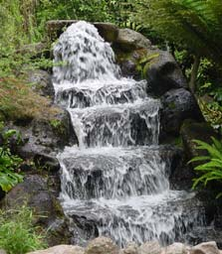
The well spring of life

Slide 7
COMPARISON BETWEEN
PHYSICAL HEART
SPIRITUAL HEART
Location:
CENTER of man’s breast
Very CENTER of a leader’s THOUGHTS, WORDS, ACTIONS and MIND

Slide 8
COMPARISON BETWEEN
PHYSICAL HEART
SPIRITUAL HEART
Contents:
Blood contains NUTRIENTS that comes from the food we eat
Obtained by eating the WORD of God and from what he consumes through his MIND and EXPERIENCE.

Slide 9
COMPARISON BETWEEN
PHYSICAL HEART
SPIRITUAL HEART
Beating:
AUTOMATIC without the conscious effort of the owner.
Shows God’s love, joy and peace NATURALLY, SPONTANEOUSLY without any insincere put-on.

Slide 10
COMPARISON BETWEEN
PHYSICAL HEART
SPIRITUAL HEART
If functioning properly:
Blood is PUMPED from one end of the body to the other.
CIRCULATES the life of the Holy Spirit throughout the Body of Christ.

Slide 11
COMPARISON BETWEEN
PHYSICAL HEART
SPIRITUAL HEART
On caring:
HIGH-Fat diet
Taking in RICH truths without practicing them

Slide 12
THE PHYSICAL HEART

Slide 13
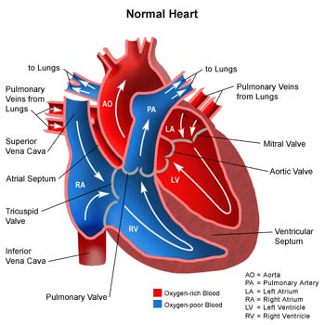
THE PHYSICAL HEART

Slide 14
COMPARISON BETWEEN
PHYSICAL HEART
SPIRITUAL HEART
On caring:
Dabbling with the wine of PLEASURES and CARES of the word
ALCOHOLIC beverages

Slide 15
COMPARISON BETWEEN
PHYSICAL HEART
SPIRITUAL HEART
On caring:
LESS exercise
Does not COMPLETELY perform the will of God

Slide 16
COMPARISON BETWEEN
PHYSICAL HEART
SPIRITUAL HEART
On caring:
More TENSION and STRESS
High-adrenalin lifestyle but NOT ENTRUSTING all cares to the Lord

Slide 17
COMPARISON BETWEEN
PHYSICAL HEART
SPIRITUAL HEART
On caring:
INHERITED heart defects
Have not fully REPENTED at the time of spiritual rebirth

Slide 18
HOW TO CONQUER IMPURITY?
S – SHIELD yourself from the external influences of the world (Hebrew 11:25)
T – TREAT sin as your enemy (Rom. 12:9)
R – Run from the lust of the flesh (2 Tim. 2:22a)
I – IMAGINE the consequences of your sin from those you love (Ex. 34:7b)
P – PURSUE righteousness, faith, love and peace (2 Tim. 2:22b)

Slide 19
HOW TO HAVE A NEW START?
A – ASK for forgiveness (1 John 1:9)
1 – 180° Turn (2 Tim. 2:19)
D – DECIDE to let the Holy Spirit control you
(Gal. 5:16)

Slide 20
CONCLUSION:
¹⁰ Create in me a pure heart, O God, and renew a steadfast spirit within me. ¹¹ Do not cast me from your presence or take your Holy Spirit from me. ¹² Restore to me the joy of your salvation and grant me a willing spirit, to sustain me.
Psalm 51:10-12

Slide 21
Assignment:
Bring a White Business Envelope
Enclose about 40 pcs. of paper cut from a short bond paper

