Slide 1
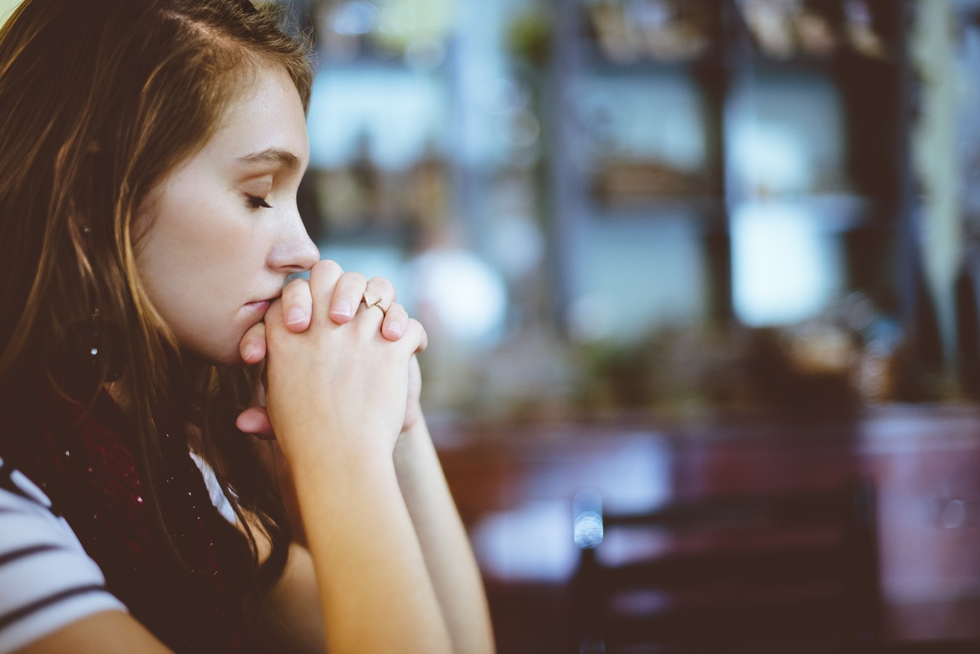
LESSON 9:
PRAYER AND
INTERCESSION

Slide 2
LESSON 9: PRAYER AND INTERCESSION
²² Immediately Jesus made the disciples get into the boat and go on ahead of him to the other side, while he dismissed the crowd.
Matthew 14:22-23

Slide 3
LESSON 9: PRAYER AND INTERCESSION
Evening Prayer
²³ After he had dismissed them, he went up on a mountainside by himself to pray. When evening came, he was there alone,
Matthew 14:22-23

Slide 4
LESSON 9: PRAYER AND INTERCESSION
Dawn Watch Prayer
³⁵ Very early in the morning, while it was still dark, Jesus got up, left the house and went off to a solitary place, where he prayed.
Mark 1:35

Slide 5
LESSON 9: PRAYER AND INTERCESSION
Over Night Prayer
¹² One of those days Jesus went out to a mountainside to pray, and spent the night praying to God.
Luke 6:12

Slide 6
LESSON 9: PRAYER AND INTERCESSION
Why Pray?
Prayer helps us RESIST the devil. (Ephesians 6:12-13, 18)
In prayer, we can ASK God for what we need. (James 4:2)

Slide 7
LESSON 9: PRAYER AND INTERCESSION
Why Pray?
When we pray in our times of need, God will grant MERCY and GRACE (Hebrews 4:16)
In thankful prayer, our anxieties are turned into PEACE. (Philippians 4:6-7)

Slide 8
LESSON 9: PRAYER AND INTERCESSION
Hindrances to Prayer?
Resentment or unforgiving spirit (Mark 11:24-25)
Sin or guilt (Isaiah 59:2)
Doubt (James 1:6-7)
Not God’s will (1 John 5:14)
Pride (Luke 18:10-14)

Slide 9
LESSON 9: PRAYER AND INTERCESSION
What is Prayer?
Prayer is mainly creating an OPEN, EMPTY space where God can COME IN and be our FRIEND.

Slide 10
LESSON 9: PRAYER AND INTERCESSION
How should we Pray?
Pray in SECRET

Slide 11
⁵ “And when you pray, do not be like the hypocrites, for they love to pray standing in the synagogues and on the street corners to be seen by men. I tell you the truth, they have received their reward in full.
Matthew 6:5-6

Slide 12
⁶ But when you pray, go into your room, close the door and pray to your Father, who is unseen. Then your Father, who sees what is done in secret, will reward you.
Matthew 6:5-6

Slide 13
LESSON 9: PRAYER AND INTERCESSION
How should we Pray?
Pray in SECRET
Pray with MEANING

Slide 14
⁷ And when you pray, do not keep on babbling like pagans, for they think they will be heard because of their many words. ⁸ Do not be like them, for your Father knows what you need before you ask him.
Matthew 6:7-8

Slide 15
LESSON 9: PRAYER AND INTERCESSION
How should we Pray?
Pray in SECRET
Pray with MEANING
Pray in PRAISE

Slide 16
⁹ “This, then, is how you should pray:
‘Our Father in heaven,
hallowed be your name,
¹⁰ your kingdom come,
your will be done
on earth as it is in heaven.
Matthew 6:9-10

Slide 17
LESSON 9: PRAYER AND INTERCESSION
How should we Pray?
Pray in SECRET
Pray with MEANING
Pray in PRAISE
Pray in SUPPLICATION

Slide 18
Give us today our daily bread.
Matthew 6:11

Slide 19
LESSON 9: PRAYER AND INTERCESSION
How should we Pray?
Pray in SECRET
Pray with MEANING
Pray in PRAISE
Pray in SUPPLICATION
Pray in CONFESSION

Slide 20
Seven days without PRAYER makes one WEAK

Slide 21
¹² Forgive us our debts, as we also have forgiven our debtors. ¹³ And lead us not into temptation, but deliver us from the evil one.’
Matthew 6:12-13

Slide 22
LESSON 9: PRAYER AND INTERCESSION
What is Intercession?
It is a prayer to God on behalf of another person.
Prayer, petition or entreaty in favor of another.

Slide 23
LESSON 9: PRAYER AND INTERCESSION
Model for Intercession
⁵ Then he said to them, “Suppose one of you has a friend, and he goes to him at midnight and says, ‘Friend, lend me three loaves of bread,
Luke 11:5-8

Slide 24
LESSON 9: PRAYER AND INTERCESSION
Model for Intercession
⁷ “Then the one inside answers, ‘Don’t bother me. The door is already locked, and my children are with me in bed. I can’t get up and give you anything
Luke 11:5-8

Slide 25
LESSON 9: PRAYER AND INTERCESSION
Model for Intercession
⁸ I tell you, though he will not get up and give him the bread because he is his friend, yet because of the man’s boldness he will get up and give him as much as he needs.
Luke 11:5-8

Slide 26
LESSON 9: PRAYER AND INTERCESSION
Model for Intercession
intercession
friend
B
friend
C
A
There is an URGENT NEED.
There is a WILLING LOVE.
There is a sense of POWERLESSNESS.

Slide 27
LESSON 9: PRAYER AND INTERCESSION
Model for Intercession
intercession
friend
B
friend
C
A
There must be FAITH in prayer.
There must be BOLDNESS.
There will be REWARD.

Slide 28
⁹ “So I say to you: Ask and it will be given to you; seek and you will find; knock and the door will be opened to you. ¹⁰ For everyone who asks receives; he who seeks finds; and to him who knocks, the door will be opened.
Luke 11:9-10

Slide 29
LESSON 9: PRAYER AND INTERCESSION
What is Fasting
Fasting is a VOLUNTARY denial of the normal function for the sake of intense spiritual activity.

Slide 30
LESSON 9: PRAYER AND INTERCESSION
Why is Fasting important?
Fasting GLORIFIES God.
Fasting REVEALS the things that control us.
Fasting keeps our DESIRES under control.
Fasting can bring about spiritual BREAKTHROUGH.

Slide 31
VALUE FORMATION
Why is Fasting important?
Do we have difficulty in praying? What are our hindrances in prayer?
Make list of three things/people you will intercede for this week and share any results of your perseverance.

Slide 32
VALUE FORMATION
Why is Fasting important?
What do you think you need to fast from to help you grow in your spiritual lifeand make your prayers more effective? Resolve to do that at a certain time everyday this week?

