Slide 1
The Word
The World
Poor in spirit
God-sufficient
Self-sufficient
Mourn
Repentant
Repeater
Meek
Gentle
Rude
Hungry and Thirsty after Righteousness
I need more of God
I need more and more
Merciful
Forgive
Revenge
Pure in heart
Focus on God
Focus on “I”
Peacemaker
Quest for God
Quest for power

Slide 2
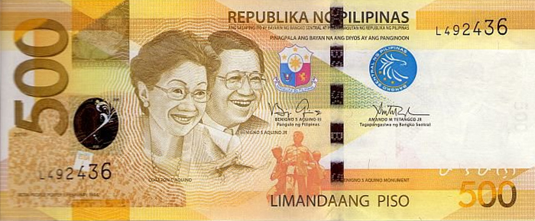

Slide 3
Finally, forgive me, my love, for not having been an ideal, good and thoughtful father to you all as I pursued public office. I had hopes and high resolve of making up, but I am afraid my destiny will not oblige.

Slide 4
I seal this letter with a drop of tear and a prayer in my heart, that somehow, somewhere we shall meet again and I will finally be able to make up for all my lapses, in the kingdom where justice reigns supreme and love is eternal.
- Ninoy Aquino, in his letter to Ballsy August 18, 1973, Fort Bonifacio Makati, Rizal

Slide 5
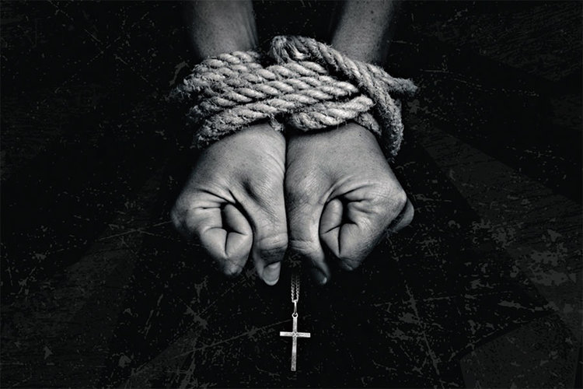
LESSON 10:
PERSECUTION

Slide 6
¹⁰ “Blessed are those who are PERSECUTED because of RIGHTEUOSNESS for theirs is the KINGDOM of heaven. ¹¹ "Blessed are you when people INSULT you, PERSECUTE you and FALSELY say all kinds of evil against you BECAUSE of me.
Matthew 5:10-12

Slide 7
¹² REJOICE and be glad, because GREAT is your reward in heaven, for in the SAME way they persecuted the PROPHETS who were before you.
Matthew 5:10-12
Greek: ‘dioko’ means to pursue

Slide 8
JESUS EMPHASIZED THREE (3) FACTS:
Persecution is an evidence of our citizenship in heaven
“Blessed are those who are persecuted because of righteousness, FOR THEIRS IS THE KINGDOM OF GOD.
Matthew 5:10

Slide 9
JESUS EMPHASIZED THREE (3) FACTS:
“When” persecution will happen
"Blessed are you when people insult you, persecute you and falsely say all kinds of evil against you BECAUSE OF ME.
Matthew 5:11

Slide 10
JESUS EMPHASIZED THREE (3) FACTS:
The inevitability of persecution is a lesson supported by history
… for in the same way they persecuted the PROPHETS WHO WERE BEFORE YOU.
Matthew 5:12

Slide 11
THE DEATH OF THE DISCIPLES
Andrew – crucified for 2 days (yet still preaching).
Batholomew – beaten, flayed alive, crucified and beheaded.
James (son of Alphaeus) – beaten and stoned to death at 94; brain dashed out, hit by a club.
Philip – martyred at Hierapolis.
Peter – crucified head downwards (time of Nero AD68).

Slide 12
THE DEATH OF THE DISCIPLES
James (son of Zebedee) – beheaded (his accuser was beheaded with him).
Judas (son of James) – killed with clubs and stones; crucified in Turkey.
Matthew – martyred with spikes in Ethiopia.
Simon (the Zealot) – crucified.

Slide 13
THE DEATH OF THE DISCIPLES
Thomas (Didymus) – martyred with a spike.
Matthias – stoned to death and beheaded.
John (the beloved) – immersed in boiling oil but was unharmed; exiled in Patmos; the only disciple who died a natural death.

Slide 14
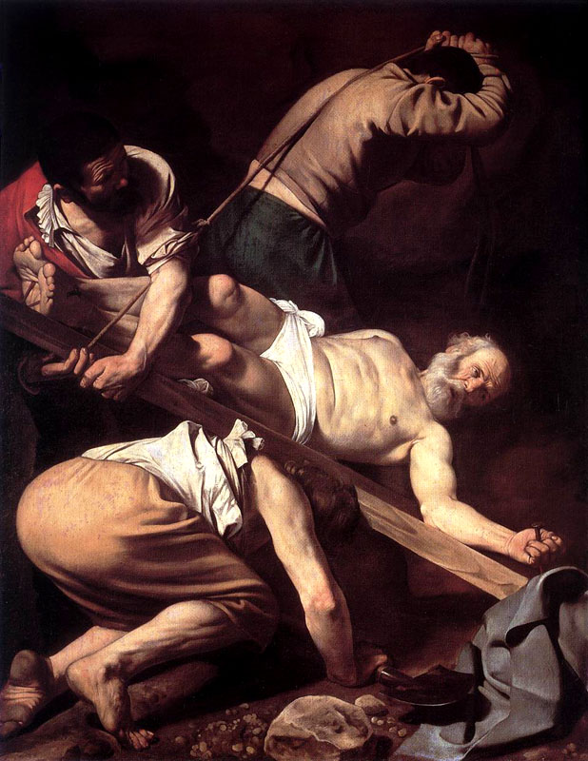
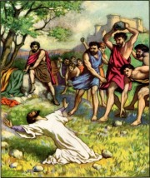
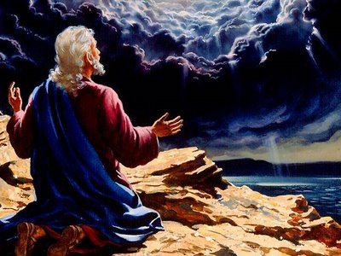
THE DEATH OF THE DISCIPLES

Slide 15
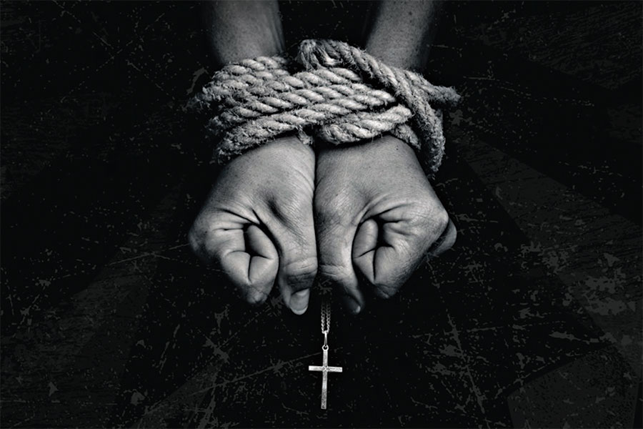
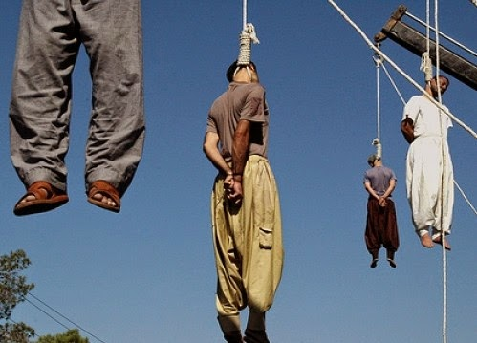

Slide 16
WHAT KIND OF PERSECUTION IS JESUS TRYING TO TELL US?
Jesus was talking about ongoing, non-stop persecution that hurts both body and pride. For righteousness (and not because of our own sin). Sometimes it is physical. Sometimes it is not. (curses, evil language, insults, mocking)

Slide 17
HOW DO WE PREPARE FOR PERSECUTION?
¹³ Who is going to harm you if you are eager to do good? ¹⁴ But even if you should suffer for what is right, you are blessed. "Do not fear what they fear; do not be frightened.”
1 Peter 3:13-18

Slide 18
HOW DO WE PREPARE FOR PERSECUTION?
¹⁵ But in your hearts set apart Christ as Lord. Always be prepared to give an answer to everyone who asks you to give the reason for the hope that you have. But do this with gentleness and respect,
1 Peter 3:13-18

Slide 19
HOW DO WE PREPARE FOR PERSECUTION?
¹⁶ keeping a clear conscience, so that those who speak maliciously against your good behavior in Christ may be ashamed of their slander.
1 Peter 3:13-18

Slide 20
HOW DO WE PREPARE FOR PERSECUTION?
¹⁷ It is better, if it is God's will, to suffer for doing good than for doing evil. ¹⁸ For Christ died for sins once for all, the righteous for the unrighteous, to bring you to God. He was put to death in the body but made alive by the Spirit..”
1 Peter 3:13-18

Slide 21
HOW DO WE PREPARE FOR PERSECUTION?
S – Sanctify the Lord in your heart.
T – Take care of your conscience.
A – Always be ready to give defense for the reason of your hope with gentleness and respect.
R – Remember you are blessed if you suffer for Christ for doing good.
T – Take Christ as the example.

Slide 22
PERSEVERING THROUGH PERSECUTION
E – Expect persecution (v. 12)
R – Rejoice for persecution (vv. 13-14)
E – Examine your life (vv. 15-18)
C – Commit yourself to God (v. 19).

Slide 23
PERSEVERING THROUGH PERSECUTION
Do not let persecution be an excuse for misconduct!
Commit yourself to God, who is our faithful creator!

Slide 24
CONCLUSION
P –PRAY for boldness.
“Now, Lord, consider their threats and enable your servants to speak your word with great boldness.”
Acts 4:29

Slide 25
CONCLUSION
H – Always have HOPE.
¹⁰ And the God of all grace, who called you to his eternal glory in Christ, after you have suffered a little while, will himself restore you and make you strong, firm and steadfast.
1 Peter 5:10

Slide 26
CONCLUSION
S – STAND FIRM and keep your faith.
⁹ Then you will be handed over to be persecuted and put to death, and you will be hated by all nations because of me. ¹⁰ At that time many will turn away from the faith and will betray and hate each other,
Matthew 24:9-13

Slide 27
CONCLUSION
S – STAND FIRM and keep your faith.
¹¹ and many false prophets will appear and deceive many people. ¹² Because of the increase of wickedness, the love of most will grow cold, ¹³ but he who stands firm to the end will be saved.”
Matthew 24:9-13

